Slide 1


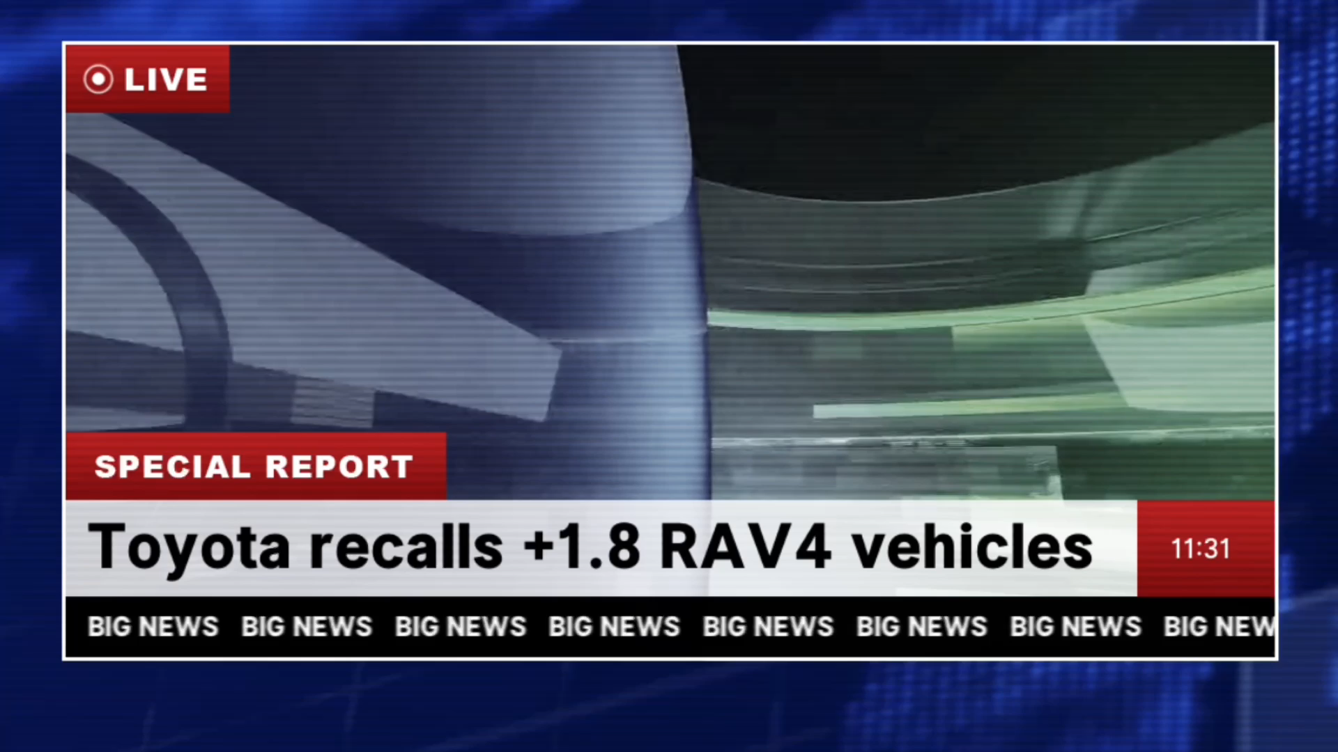

Slide 2

FIRMWARE OVER THE AIR
Bootloader Development

Slide 3
Who are we
01
Fota
02
Applicatios
Bootloader
TABLE OF CONTENTS
04
03
Future Vision
05
Conculsion
06
Team members, Idea, wokflow and Timeline
Introduction to the FOTA and it’s security
Obstacle Avoidance, Lane keeping system
And V2V
Introduction to the bootloader with its features
Tomorrow's brilliance starts with today's imagination.
Summary and References

Slide 4






01
Who are we
Omar Abou Zaid
Mostafa Khalil
Team members, Idea, wokflow and Timeline
Maisara Rashad
Ahmed Ibrahim
Mahmoud Salah

Slide 5
Who are we
01
Mostafa Khalil
Omar Abou Zaid
Maisara Rashad
Ahmed Ibrahim
Mahmoud Salah

Slide 6

Idea
The integration of a reliable bootloader and a secure FOTA update mechanism ensures that devices can be updated remotely, enhancing their functionality, security, and reliability
over time and Implementing this idea using RC Car

Slide 7


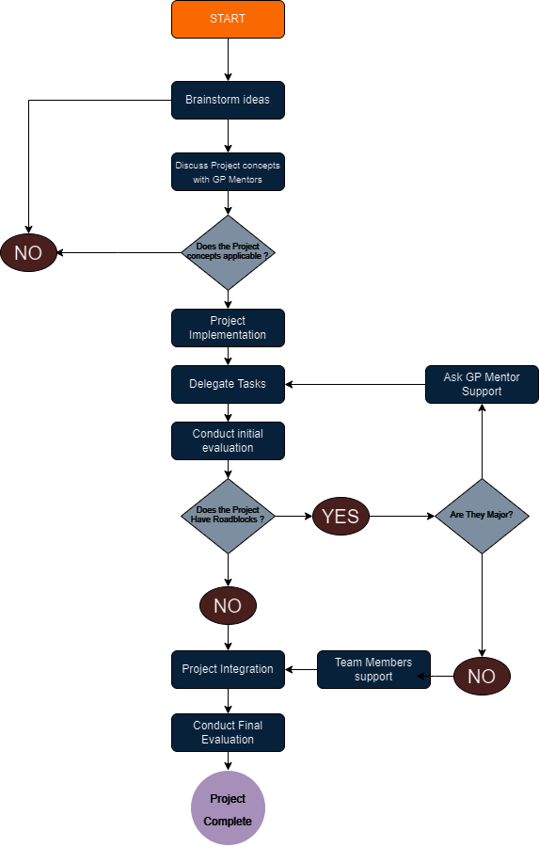
Work flow diagram
A visual aid, like a workflow diagram, presents a concise overview of the sequential steps or tasks in a process. It highlights how work unfolds and demonstrates the logical progression of our team's thinking from one stage to the next.

Slide 8
Work flow diagram
A visual aid, like a workflow diagram, presents a concise overview of the sequential steps or tasks in a process. It highlights how work unfolds and demonstrates the logical progression of our team's thinking from one stage to the next.

Slide 9

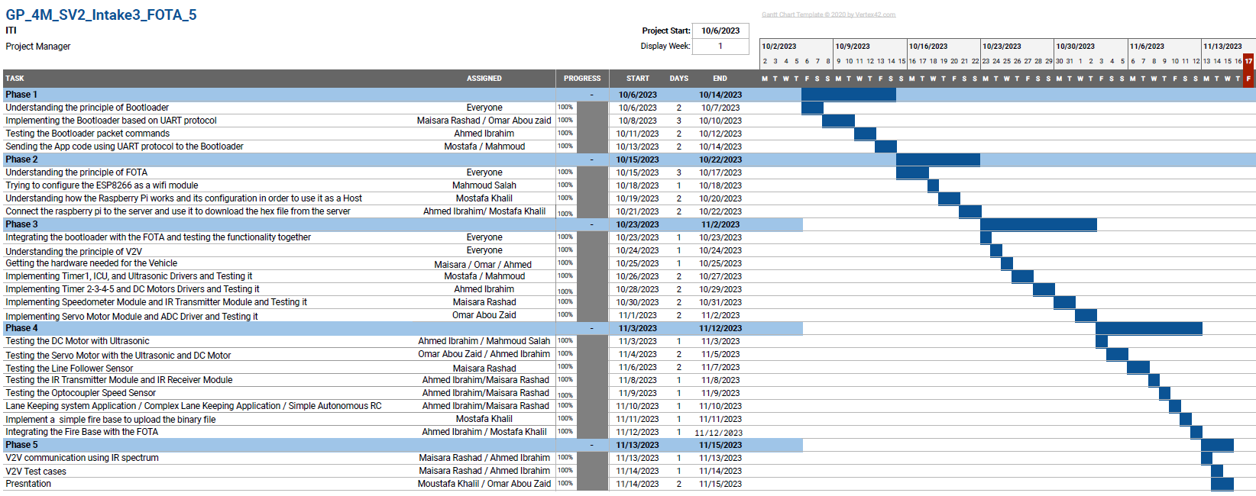
Our Timeline

Slide 10

02
FOTA

Slide 11
02
FOTA
Firmware Over-the-Air

Slide 12
What is FOTA?
Firmware Over-The-Air (FOTA) in embedded systems allows wireless deployment of firmware updates, improvements, bug fixes, and new features to devices after they have been deployed in the field, enhancing the efficiency and reliability.

Slide 13
FOTA Features
Check for Update:
Determine the availability of newer firmware versions from the server (Firebase).
Get the Update from the Server:
This process encompasses establishing a secure connection, downloading the firmware update package, and validating the version of the downloaded update.
Encryption:
Implemented Fernet encryption as an advanced security measure, creating a unique code accessible only to your device and the server.
Error Handling:
Implement error handling mechanisms to retry downloads, validate firmware integrity, and handle communication failures.

Slide 14
FOTA Features
Flash the Code on the Device:
involves the process of writing the new firmware onto the device's memory, replacing the existing code with the updated version seamlessly and reliably.
Improvements in Performance:
This feature ensures the continuous improvement of the device's operational stability and reliability through firmware updates.
Each of these features is instrumental in orchestrating a secure, systematic, and efficient FOTA update process, fostering the reliability, security, and enhanced performance of electronic devices.

Slide 15



FOTA Process
Security
Authentication
Integrity
FIREBASE
OEM
Vehicle
FERNET KEY
FERNET KEY

Slide 16

03
Bootloader
Introduction to the bootloader with its features

Slide 17


Introduction
In embedded systems, a bootloader is a small program or piece of code that resides in the non-volatile memory of a microcontroller or microprocessor. Its primary function is to initialize the system and load the main application program (firmware) into the system’s RAM or flash memory for execution. Here are the key functions and characteristics of a bootloader in embedded systems:
-Initialization -Loading Firmware -Boot Mode Selection
-Security -Communication Interface
-Error Handling -Flexibility and Customization

Slide 18

Bootloader Features
256 Kbytes flash memory.
Bootloader Code area from Sector 0 to Sector 1.
Application Code area from Sector 2 and Sector 5.
Bootloader is flashed in the STM32F401CC.
The Host will be the Raspberry pi 3.
The Bootloader in STM32 MCU will process the command sent by the Host and then reply to the host with ACK or NOT_ACK.
The Host can send non valid command, and the bootloader in this case, will send NOT_ACK to the Host.

Slide 19
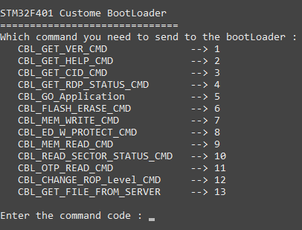
Bootloader Commands
Read the Bootloader Version From the MCU
Read the supported Command from the MCU
Read Chip Identification Number From the MCU
Read the Protection Level of the MCU
Go To Application Code to start the Vehicle.
Flash Erase of the MCU with start sector and number of sectors to be erased inside the MCU.
Write to specific address inside the flash of the MCU, and to flash the application binary code starting from specified address.
Change Flash Protection Level of the MCU

Slide 20
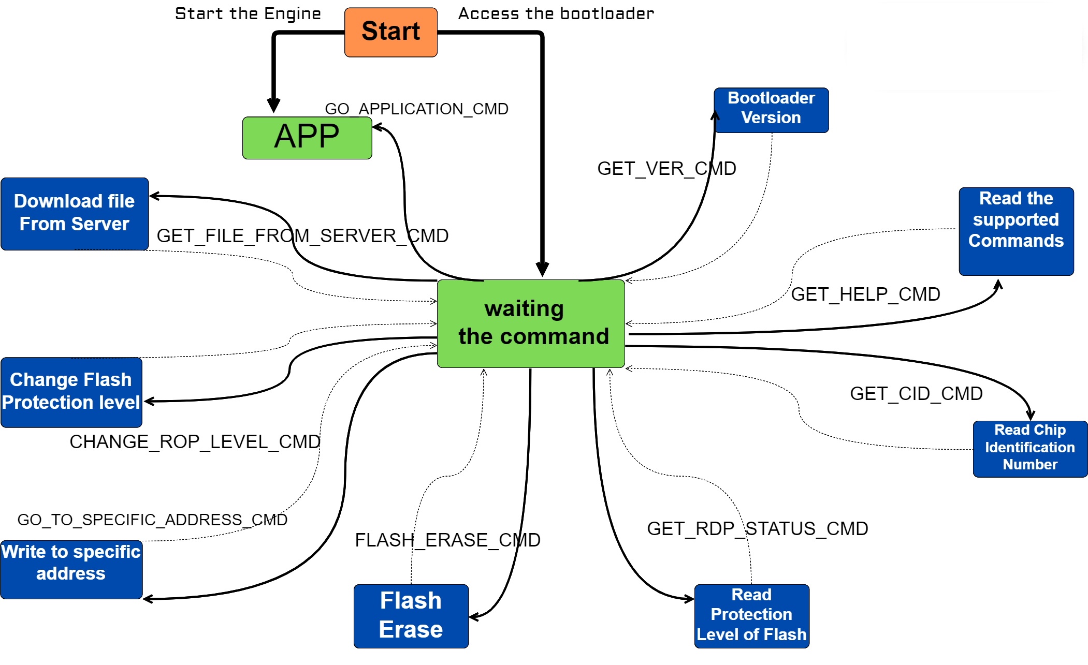

Infinite State Machine

Slide 21
Test Cases
No. | Description | Expected Result | Actual Result | Pass | Fail
1 | UART functionality | Sending/Receiving data through the UART Protocol | As Expected | PASS
2 | Flash driver functionality | Flash Specific Code in STM32F401CC Flash Memory | As Expected | PASS
3 | Developing a Python script Code to send the Command Packets | Send command Packet from the Raspberry Pi to the STM32F401CC Through the UART Protocol | As Expected | PASS
4 | Developing a parsing code for the boot loader to parse the received command from the Python script
5 | Get the Bootloader Version from STM32F401CC | Send command Packet that specified for the Bootloader Version | As Expected | PASS
6 | Get the Chip Identification Number from STM32F401CC | Send a command Packet that specifies the Chip ID Number | As Expected | PASS
7 | Get the Commands Supported by Bootloader from STM32F401CC | Send a command Packet that specified for the Supported Command By the Bootloader | As Expected | PASS
8 | Mass Erase or Sector Erase by Number of Sectors to STM32F401CC | Send command Packet that specified for Mass Erase or Sector Erase | As Expected | PASS

Slide 22
Test Cases
No. | Description | Expected Result | Actual Result | Pass | Fail
9 | Write from a specific address of the Flash Memory | Send the Command Packet to the Bootloader to write into a specific Memory location inside the Flash Memory | As Expected | PASS
10 | Jump to Application Code (Application is developed using Arm Keil IDE) | Send the Command Packet to the Bootloader to jump to the Application Code In the STM32F401CC | As Expected | PASS
11 | Jump to Application Code (Application is developed using Eclipse IDE) |  | Problem: The Stack size of the ARM Keil’s linker script is very low compared to Eclipse’s Linker Script. Solution: Increase the Stack Size of the Bootloader to make the Stack Pointer start from the end of the RAM | PASS
12 | Get the updated code from the server | Get the Code from the server and decrypt it to be ready to be flashed into the Flash Memory | As Expected | PASS
13 | Check for Update | If there is an update, it will ask you to download the code or not. If there is no update, it will tell you that you are up to date. | As Expected | PASS

Slide 23

04
Application
Obstacle Avoidance, Lane keeping system and V2V

Slide 24

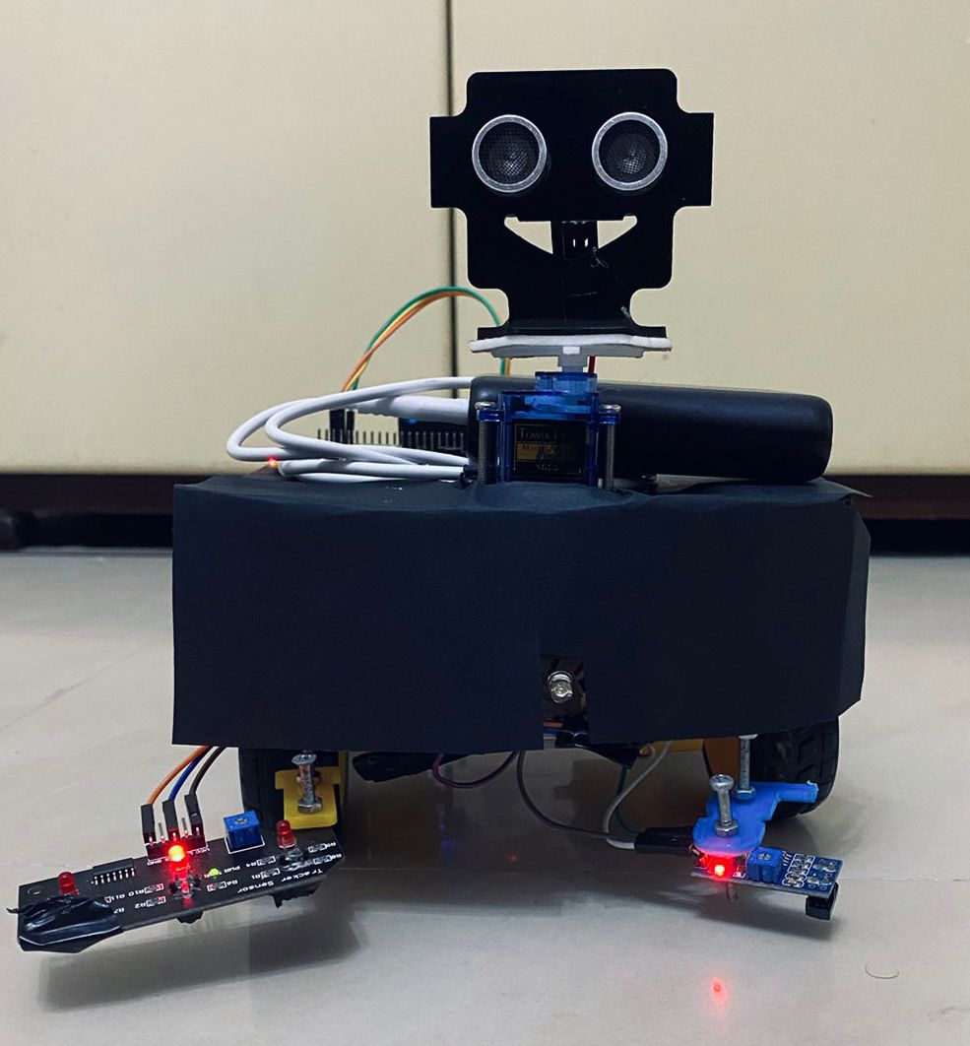
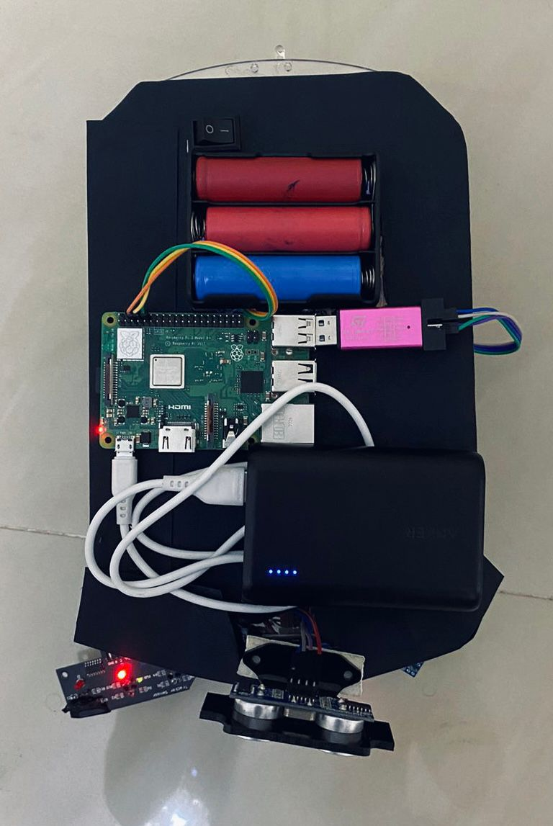
Application
The Application can operate in Three Modes which are:
Lane Keeping System
Obstacle Avoiding System
V2V
Component used
Hardware Snapshots
Four DC motor
DC motor Driver
Two Line follower sensors
IR Transmitter and Receiver LEDS
STM32F401CCU6
Raspberry pi 3
Power Bank to power the Raspberry pi
Servo motor
Ultrasonic Sensor
Optocoupler sensor

Slide 25
Lane Keeping System
A Lane Keeping System utilizes sensors to monitor the vehicle's position on a designated path. Real-time data processing allows the system to autonomously adjust the steering, keeping the RC car aligned within the lane by applying steering torque.
Test Cases
No. | Description | Expected Result | Actual Result | Pass | Fail
1 | DC motors operation | Run the Dc motor forward and reverse | As Expected | PASS
2 | Testing Line follower sensor with external interrupts | Get a rising edge whenever detecting a line | As Expected | PASS
3 | Consolidating the entire project into a single function and verifying its functionality | Lane keeping system integration | As Expected | PASS

Slide 26
Obstacle Avoidance
Obstacle avoiding system prevents car accidents by detecting any moving objects. Taking decisions and measuring surrounding distances to select the best route to go through.
Test Cases
No. | Description | Expected Result | Actual Result | Pass | Fail
1 | DC motors operation | Run the Dc motor forward and reverse | As Expected | PASS
2 | Servo motor operation | Move the Servo motor in different angles | As Expected | PASS
3 | Ultrasonic operation with ICU | Get the distance from objects | As Expected | PASS
4 | Testing Ultrasonic with the servo movement | Getting distance for different angles | As Expected | PASS
5 | Consolidating the entire project into a single function and verifying its functionality | Obstacle avoiding car integration | As Expected | PASS

Slide 27
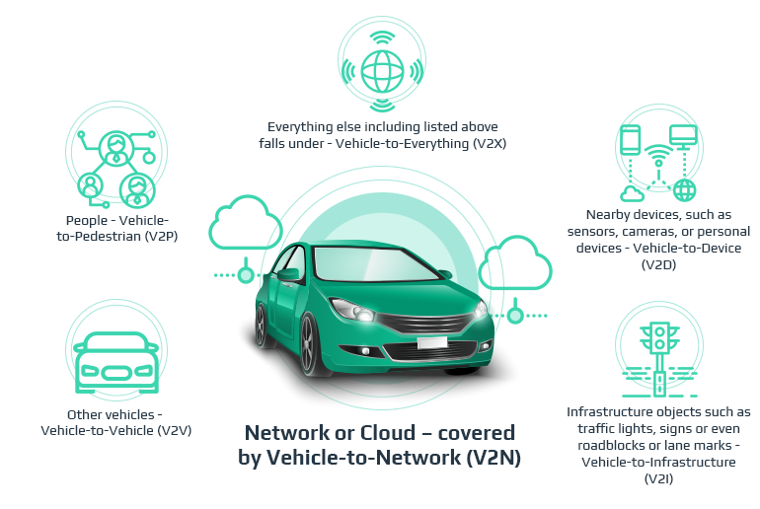
Vehicle to Vehicle

Slide 28
Vehicle to Vehicle
V2V mode refers to a communication technology that enables direct communication between vehicles on the road. In V2V mode, vehicles exchange information with each other. This exchange of data allows vehicles to share important information such as speed and direction.
Test Cases
No. | Description | Expected Result | Actual Result | Pass | Fail
1 | IR transmitter Driver | Sending command and data frame with IR Leds by generating accurate PWM signals with specific duty cycle and frequency | As Expected | PASS
2 | IR receiver Driver | Receiving data with IR Leds according to the command and data frame sent by IR transmitter | As Expected | PASS
3 | Optocoupler sensor operation | Get the Dc motor RPM | As Expected | PASS
4 | Send distance measured by the front vehicle to the rear vehicle | If the distance is less than specified value, the rear vehicle will stop and If the distance is greater than specified value, the rear vehicle will move | Problem: IR transmitter and receiver modules weren’t accurate as we expected. Solution: Providing an external power source for the IR modules made the system more stable. | PASS

Slide 29

05
Future Vision
Tomorrow's brilliance starts with today's imagination.

Slide 30
A Glimpse into Tomorrow
Implement RTOS to schedule all tasks
Strategic Integration: RTOS into FOTA
Real-Time Responsiveness Enhancement
Optimized Resource Management Excellence
Bootloader Based on CAN Protocol
Adaptive Cruise Control

Slide 31

06
Conclusion
Summary and References

Slide 32
The seamless integration of Firmware Over-The-Air (FOTA) and Bootloader not only represents a technical achievement but signifies a transformative shift in the realm of connected devices. This conclusion marks not an endpoint but the beginning of a trajectory where our innovations contribute to a future of smarter, more adaptive, and resilient devices that will shape the technological landscape for years to come. Thank you for joining us on this journey into the future of device evolution.

Slide 33

Your Car’s New Software Is
Ready.
Update Now?

Slide 34

THANKS
any questions?
References :
-Project on GitHub.
-Project Documentation.

